Slide 1
Evergreen Insurance – Quoting Platform Delivery Review & Stakeholder Demo
Presented by: Ajit Ranjan Sahu
Wednesday, September 2, 2026

Slide 2
Delivery Goals and Outcomes
Goals:
Deliver a production-ready Phase 2 Evergreen Quote experience
Give first-time insurance shoppers a fast, low-commitment estimate
Show the premium live as the user types
Finish with green type-check, build, and CI
Outcomes:
Shoppers can select auto, home, or life coverage and see the premium update instantly , with no Calculate button.
The experience stays fast, simple, and low-commitment for first-time shoppers comparing options on mobile.
The Recent Quotes panel loads from the data feed and shows clear loading, error, and success states.
Stakeholders can verify that the estimates are credible and aligned with the sponsor’s placeholder rate decision.
The solution is production-ready, with npm run type-check, npm run build, and CI on master all passing
For Internal Use only

Slide 3
What is Shipping
Shipping with MVP:
A fast, mobile-friendly quote experience for auto, home, and life
A live premium estimate that updates instantly as the shopper types
A Recent Quotes view with clear loading and error handling
A simple, low-commitment experience designed for first-time shoppers
A stable release backed by green type-check, build, and CI
Deferred features:
Real backend pricing and actuarial rate logic
Accounts, saved quotes across visits, and purchase flow
Broader site navigation and additional features beyond the core quote experience
Demo URL:
https://ajit5144.github.io/Evergreen_Capstone_Phase_2/
For Internal Use only

Slide 4
Key Delivery Decisions
Zip code field request:
Marketing requested a ZIP-code field for regional pricing, but adding it would have required updates beyond the UI, including pricing logic, validation, shared types, and review.
The team chose not to take on that change in the current delivery window in order to protect the committed scope and avoid destabilizing the core quote flow.
The decision kept focus on shipping the live estimate experience, recent quotes, and a green type-check/build/CI path.
Premium Discrepancy Incident:
A customer-facing premium issue was reported at the same time a recent hotfix left master red in CI, creating uncertainty about whether the two issues were related.
Even though the delivery branch could be healthy, the team chose not to merge into a broken master while there was still an unresolved pricing concern.
The decision was to hold merge until engineering confirmed the root cause, resolved the premium issue as needed, and restored master to a green CI state.
For Internal Use only

Slide 5
Risks and Injects
Risk | Impact | Mitigation
No automated tests | Medium | Add Smoke Tests
Security testing not completed | High | Scan before Prod deploy
Unavailable website links | Medium | Validate link post release
Injects:
Inject 1: Deferred the ZIP-code field request and stayed on the current toolchain to protect the committed delivery scope, timeline, and green build.
Inject 2: Rejected the rushed rate hotfix path after it broke type-check in CI, and chose to protect delivery stability over immediate change.
Inject 3: Made a NO-GO merge call when a customer-facing premium discrepancy appeared while master was red, pending root-cause confirmation and CI recovery.
All updates and supporting details have been captured in the project board for reference.
For Internal Use only

Slide 6
What I’d do differently next time
Lock down the pricing/config path earlier so sponsor rate changes do not arrive late and create avoidable churn in premium logic and validation.
Set up deployment-path checks sooner by validating GitHub Pages, Vite base path, and data-feed URLs earlier instead of discovering environment-specific issues after local success.
Add lightweight automated smoke tests for the core quote flow so regressions in live updates, save quote, and recent quotes are caught before manual review.
Create a clearer change-control path for late requests and hotfixes so items like ZIP-code additions or direct rate changes do not put the delivery branch and merge timeline at risk.
For Internal Use only

Slide 7
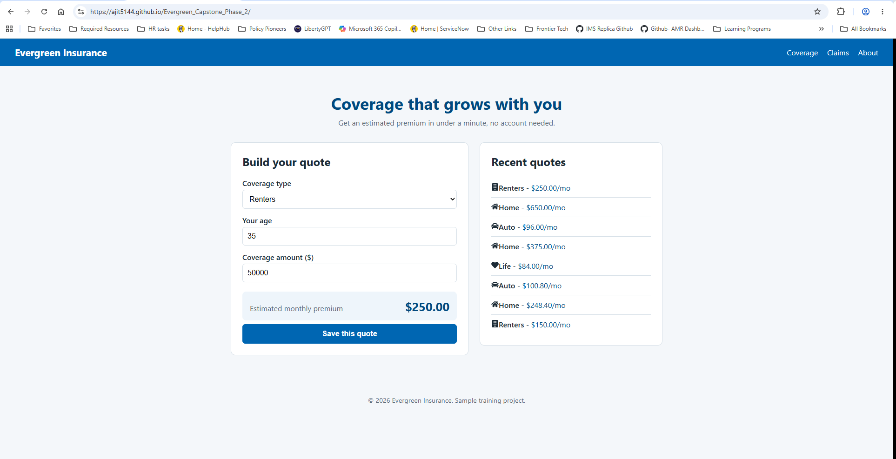
Sample Screenshot
For Internal Use only

Slide 8
Key Takeaways
Core Quote Experience Delivered
Fast, Low-Commitment Shopper Journey Enabled
Recent Quotes Experience Added for Customer Confidence
Stable Release Delivered with Green Build and CI
Deployed and Ready for Stakeholder Review
Positioned for Next-Phase Enhancements
For Internal Use only

Slide 9
Q&A
For Internal Use only

